Slide 1
CMSC 201
Computer Science I for Majors
Lecture 01 – Introduction

Slide 2
Introductions
Dr. Katherine Gibson
  Education
    BS in Computer Science, UMBC
    MS & PhD in CS, University of Pennsylvania
  Likes
    Video games
    Dogs
    Nail polish

Slide 3
Introductions
Prof. Michael Neary
  Education
    BS in Computer Science, UMBC
    MS in Computer Science, UMBC (in progress)
    PhD in Computer Science, somewhere (eventually)
  Likes
    Chocolate
    Broadway
    Improv

Slide 4
Course Overview

Slide 5
Course Information
First course in the CMSC intro sequence
  Followed by CMSC 202
CMSC majors must get a B or better
CMPE majors must get a B or better
  Unless you entered UMBC prior to Fall 2016
No prior programming experience needed
  Some may have it

Slide 6
What the Course is About
Introduction to Computer Science
  Problem solving and computer programming
We’re going to come up with algorithmic solutions to problems
  What is an algorithm?
We will communicate our algorithms to computers using the Python language

Slide 7
Class Objectives
By the end of this class, you will be able to:
  Use an algorithmic approach to solve computational problems
  Break down complex problems into simpler ones
  Write and debug programs in the Python programming language
  Be comfortable with the UNIX environment

Slide 8
Why Learn to Program?
Programming skills are useful across a wide range of fields and applications
  Many scientific professions utilize programming
  Programming skills allow you to understand and exploit “big data”
  Logical thinking learned from programming transfers to many other domains

Slide 9
Grading Scheme
This class has:
  6 Homeworks (40 points each)
    Small programming assignments
  3 Projects (80 points each)
    Larger programming assignments
  13 lab assignments (10 points each, drop 3 lowest)
  4 mandatory surveys (5 points each)
  A midterm (200 points)
  A comprehensive final exam (200 points)

Slide 10
A Note on Labs
Your “discussion” section is actually a lab
  In the Engineer building (ENG)
Labs are worth 10% of your grade
You must attend your assigned section
  No credit for attending other sections

Slide 11
Submission and Late Policy
Homeworks and projects will be submitted via the GL server with the submit command
Homeworks will always be due at 8:59:59 pm
Late homeworks will receive a zero
(In other words, there are no late homeworks)

Slide 12
Submission and Late Policy
It is not recommended that you submit close to the deadline
  Developing programs can be tricky
  and unpredictable
  Sometimes the server gets overloaded with everyone trying to submit
Start early and submit early (and often!)

Slide 13
Academic Integrity

Slide 14
Academic Integrity
We have homeworks and projects in this class
You should never, ever, ever submit work done by someone else as your own
If you submit someone else’s code, both
students will get a 0 on the assignment

Slide 15
Things to Avoid
Downloading or obtaining anyone else’s work
Copying and pasting another person’s code
Leaving your computer logged in where another student can access it
Giving your code to another student
  Or explaining it in explicit detail to another student
Attempting to buy code online
  This will result in an immediate F in the class

Slide 16
Things that are Always Okay
And encouraged!
Talking to a classmate about a concept
Getting help from a TA or instructor
Comparing program output
Discussing how to test your program
Working on practice problems together

Slide 17
Collaboration Policy
We want you to learn all these things:
  The course material
  How to work independently
  How to work collaboratively
Some assignments will be “individual work” while others will be “collaboration allowed”
  These will be clearly marked on each assignment
  You may only collaborate with current 201 students

Slide 18
What Is Allowed?
Action | Allowed for Individual Work | Allowed when Collaborating
Getting help from an instructor or TA | Allowed | Allowed
Brainstorming general solutions to the assignment | Not Allowed | Allowed
Creating, sharing, or copying course notes | Allowed | Allowed
Purchasing solutions | Not Allowed | Not Allowed
Borrowing verbatim from the course slides or book | Allowed | Allowed
Giving (or receiving) a detailed explanation | Not Allowed | Not Allowed
Looking for solutions or help online | Not Allowed | Not Allowed
Looking at someone else’s code | It Depends | It Depends

Slide 19
What Is Allowed?
Action | Allowed for Individual Work | Allowed when Collaborating
Getting help from an instructor or TA | Allowed | Allowed
Brainstorming general solutions to the assignment | Not Allowed | Allowed
Creating, sharing, or copying course notes | Allowed | Allowed
Purchasing solutions | Not Allowed | Not Allowed
Borrowing verbatim from the course slides or book | Allowed | Allowed
Giving (or receiving) a detailed explanation | Not Allowed | Not Allowed
Looking for solutions or help online | Not Allowed | Not Allowed
Looking at someone else’s code | It Depends | It Depends

Slide 20
What Is Allowed?
Action | Allowed for Individual Work | Allowed when Collaborating
Getting help from an instructor or TA | Allowed | Allowed
Brainstorming general solutions to the assignment | Not Allowed | Allowed
Creating, sharing, or copying course notes | Allowed | Allowed
Purchasing solutions | Not Allowed | Not Allowed
Borrowing verbatim from the course slides or book | Allowed | Allowed
Giving (or receiving) a detailed explanation | Not Allowed | Not Allowed
Looking for solutions or help online | Not Allowed | Not Allowed
Looking at someone else’s code | It Depends | It Depends
You may never look at someone else’s code without their permission
You may never look at someone else’s code on your computer
When collaborating, you may look at someone else’s code on their screen and with their permission
When working individually, you may not look at anyone else’s code

Slide 21
Acknowledging Collaboration
If you work with another student, you
must fill out the Collaboration Log
  Other student’s name and email
  What you discussed
Even if you only gave help
Needs to be done within 24 hours
  Do it as soon as you’re done collaborating

Slide 22
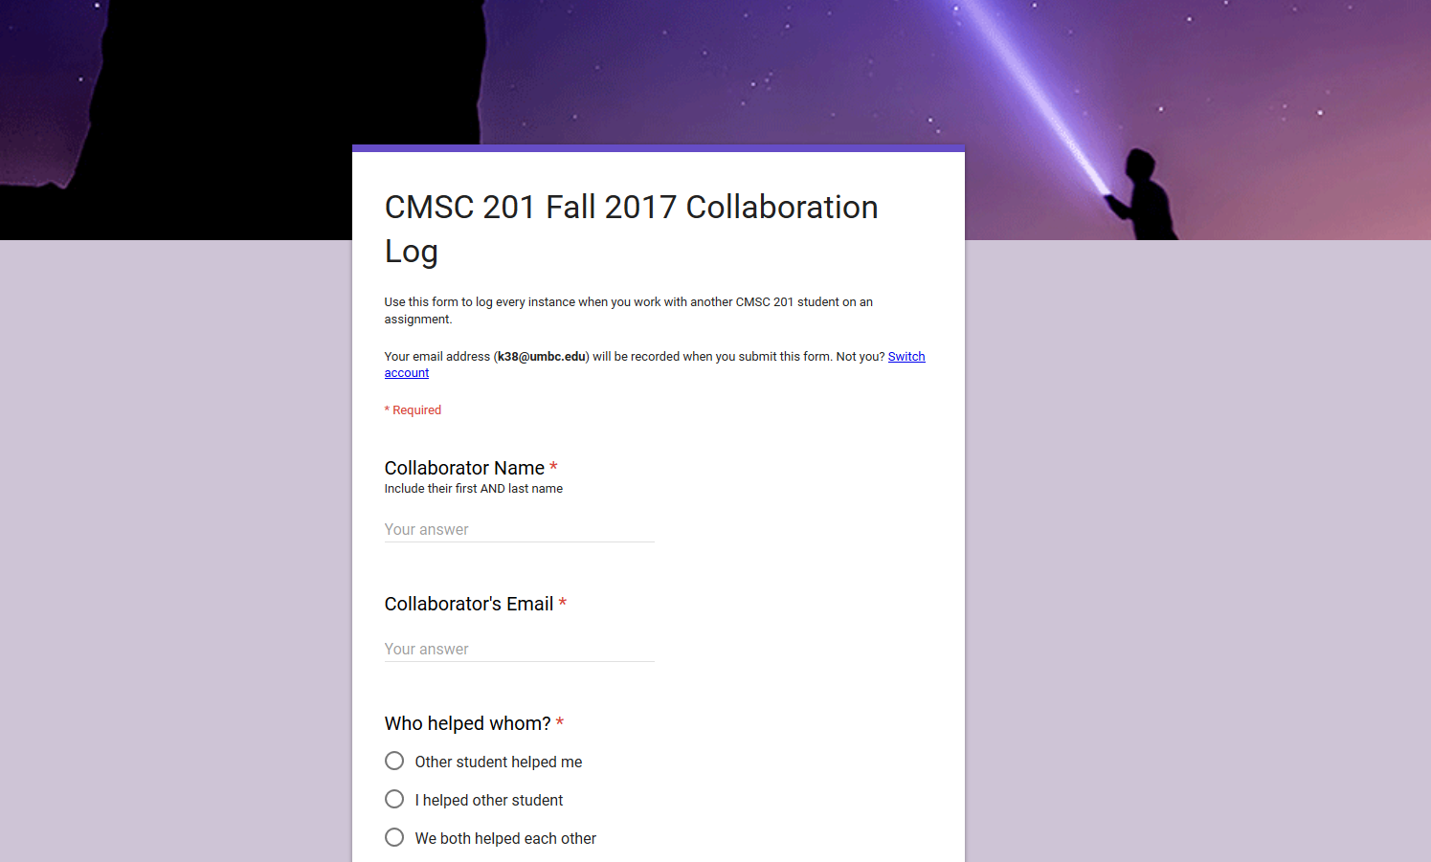

Slide 23
Why So Much About Cheating?
Every semester, a large number of students get caught for sharing code
  They’re often friends
  One student is trying to help the other out
  Or two students working to solve one problem
They both endanger their entire academic career when they get caught
  And the friend gets a zero for helping them

Slide 24
Alternatives to Cheating
Turn in a partially done assignment
  Still get partial points
  (Better than a zero for cheating)
Discuss concepts with other students,
but not assignment details
Come get help in office hours!

Slide 25
Becoming a Good Programmer
We are strict about academic integrity because we want everyone to succeed in this class
Understanding the assignment solutions means you will do better on the exams
Learning the course material means you will do better in your future courses and career
Seeking help when you need it will help you grow as a student and as a computer scientist

Slide 26
Getting Help

Slide 27
Where to Go for Help
There are a number of places you can go if you are struggling!
  All of the TAs happy to help
  If the TAs aren't working out, come by the instructors’ office hours (this should not be your first resort for help)
Office hours will be posted on the website

Slide 28
CMSC 201 TAs
You are welcome to go to any TA for help
  If you need help with an assignment
  If you have a question about course content
Final schedule will be posted on the website
Over 50 hours total each week where a TA
is available in ITE 240
  ITE 240 will be busy on the due date

Slide 29
ITE 240
This is a computer lab in the ITE building used to hold 201, 202, and 341 office hours
The 201 TAs will…
  Be wearing bright yellow lanyards
Sign in happens via a Google form, to ensure everyone is helped in a timely manner

Slide 30
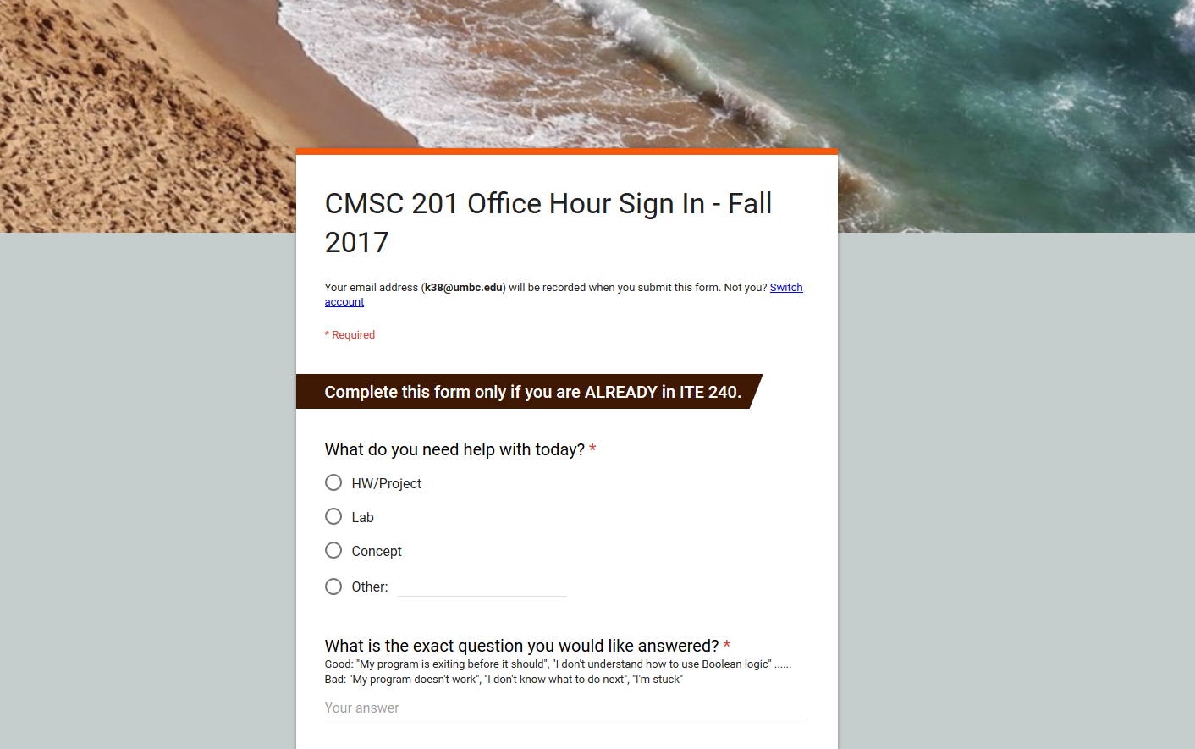

Slide 31
Additional Help
Tutoring from the Learning Resources Center
  By appointment
Computer help from DoIT
  By phone or in person
See the syllabus for more info

Slide 32
Announcement: Note Taker Needed
A peer note taker has been requested for this class. A peer note taker is a volunteer student who provides a copy of his or her notes for each class session to another member of the class who has been deemed eligible for this service based on a disability. Peer note takers will be paid a stipend for their service.
Peer note taking is not a part time job but rather a volunteer service for which enrolled students can earn a stipend for sharing the notes they are already taking for themselves.
If you are interested in serving in this important role, please fill out a note taker application on the Student Disability Services website or in person in the SDS office in Math/Psychology 212.

Slide 33
Programming Mindset

Slide 34
Taking Time
For every credit hour, you should spend at least 1 - 4 hours studying each week
  For CMSC 201, that means 4 - 16 hours
Amount of time spent depends on
assignment load and course difficulty
You won’t pass this class by spending an hour a week on the material and assignments

Slide 35
Time Spent In Class
In class, we’ll mostly focus on
  Concepts
  Ways of thinking
  Common mistakes
  More concepts
We’ll only spend a small amount of time on
  Writing programs
  Actual coding

Slide 36
Time Spent Out of Class
Learning to code and think like a
programmer is like learning any new skill
  You only get better if you practice a lot!
Assignments are designed to be practice
for the skills you need
  Spend the time to really understand them!
  Experiment! (“What happens if I do …?”)

Slide 37
“Failure”
No one gets everything right on the first try
  Especially in programming
Everyone makes mistakes when coding
  Including the professors
    You’ll see me do it almost every time we code in class
  Including the TAs
  Including you

Slide 38
Making Mistakes
A mistake is not a failure!
Don’t give up after one error or setback
  Learn from your mistakes, and get better
Don’t underestimate yourself
  You’re learning an entirely new skill set, it would be weird if you “got it” right off the bat

Slide 39
Upcoming Assignments
Homework 0 will be released soon, and will walk you through “how” to do 201 homework
  How to log onto the GL servers
  How to write and run Python code
  How to submit an assignment
  How to check submission was done correctly
Lab 1 will be an online lab
  Most other labs will be done during discussion

Slide 40
Announcements
Lab 1 will be an online lab
  Released online early next week
In-person labs won’t begin until September 11
Make sure to log into the course Blackboard
  Let us know if you have any problems
  (Students on the waitlist may not have access yet)

